Slide 1
Programming Fundamentals
By
Shazmeen Batool

Slide 2
Previous Lecture
String
C-String

Slide 3
Today’s Lecture
Introductions to Pointers

Slide 4
Getting the Address of a Variable
The address operator (&) returns the memory address of a variable.
Every variable is allocated a section of memory large enough to hold a value of the variable’s data type.
On a PC, for instance, it’s common for one byte to be allocated for chars, two bytes for shorts, four bytes for ints, longs, and floats, and eight bytes for doubles.

Slide 5

Getting the Address of a Variable
Each byte of memory has a unique address. A variable’s address is the address of the first byte allocated to that variable.
Suppose the following variables are defined in a program:

Slide 6
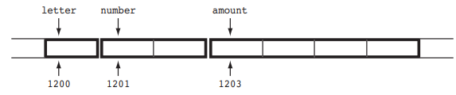
Getting the Address of a Variable
Figure below illustrates how they might be arranged in memory and shows their addresses.

Slide 7
Getting the Address of a Variable
Getting the address of a variable is accomplished with an operator in C++. When the address operator ( &) is placed in front of a variable name, it returns the address of that variable.
Here is a statement that displays the variable amount’s address on the screen:
1203

Slide 8
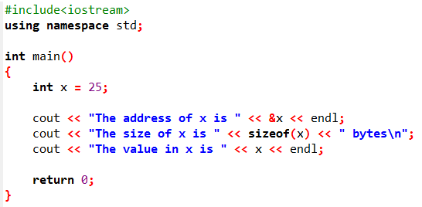

Following program demonstrates the use of the address operator to display the address, size, and contents of a variable.
The address of the variable x is displayed in hexadecimal. This is the way addresses are normally shown in C++.

Slide 9
Pointer Variables
Pointer variables, which are often just called pointers, are designed to hold memory addresses. With pointer variables you can indirectly manipulate data stored in other variables.
This should give you a clue as to why it is called a pointer: It “points” to some piece of data that is stored in the computer’s memory. Pointer variables also allow you to work with the data that they point to.
Pointer variables are also known as pointers. You can use a pointer to reference the address of an array, an object, or any variable.

Slide 10
Creating and Using Pointer Variables
The definition of a pointer variable looks pretty much like any other definition.
Here is an example:
The asterisk in front of the variable name indicates that ptr is a pointer variable. The int data type indicates that ptr can be used to hold the address of an integer variable. The definition statement above would read “ ptr is a pointer to an int.”

Slide 11
Creating and Using Pointer Variables
Some programmers prefer to define pointers with the asterisk next to the type name, rather than the variable name.
For example, the previous definition shown above could be written as:
This style of definition might visually reinforce the fact that ptr’s data type is not int, but pointer-to- int. Both definition styles are correct.

Slide 12
Creating and Using Pointer Variables
It is never a good idea to define a pointer variable without initializing it with a valid memory address.
If you inadvertently use an uninitialized pointer variable, you will be affecting some unknown location in memory.
For that reason, it is a good idea to initialize pointer variables with the special value nullptr.

Slide 13
Creating and Using Pointer Variables
In C++ 11, the nullptr key word was introduced to represent the address 0. So, assigning nullptr to a pointer variable makes the variable point to the address 0. When a pointer is set to the address 0, it is referred to as a null pointer because it points to “nothing.”
If you are using an older compiler that does not support the C++ 11 standard, you should initialize pointers with the integer 0, or the value NULL. The value NULL is defined in the iostream header file (as well as other header files) to represent the value 0.

Slide 14
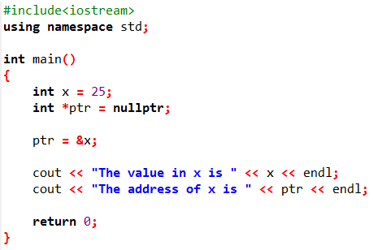

Example

Slide 15


Example
int x = 5;
int *ptr = &x;
After this statement ptr will store 0x1 in it.
x
ptr

Slide 16
Creating and Using Pointer Variables
The real benefit of pointers is that they allow you to indirectly access and modify the variable being pointed to.
This is done with the indirection operator, which is an asterisk (*).
When the indirection operator is placed in front of a pointer variable name, it dereferences the pointer.
When you are working with a dereferenced pointer, you are actually working with the value the pointer is pointing to.

Slide 17
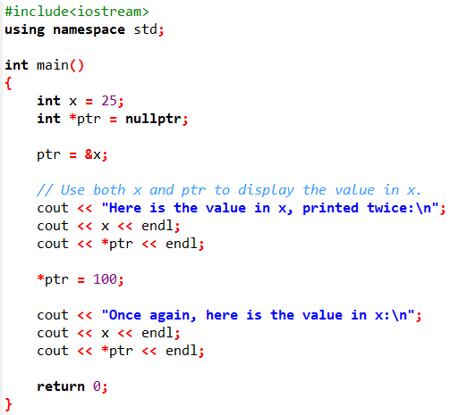
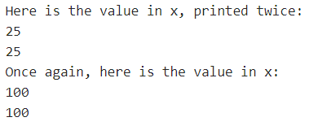
Example

Slide 18
Creating and Using Pointer Variables
Take a closer look at the statement:
ptr = &x;
This statement assigns the address of the x variable to the ptr variable. Now look at another statement:
cout << *ptr << endl;
When you apply the indirection operator ( *) to a pointer variable, you are working, not with the pointer variable itself, but with the item it points to. Because this statement sends the expression *ptr to the cout object, it does not display the value in ptr, but the value that ptr points to. Since ptr points to the x variable, this statement displays the contents of the x variable.

Slide 19
Creating and Using Pointer Variables
Suppose the statement did not use the indirection operator.
Suppose that statement had been written as:
cout << ptr << endl;
Because the indirection operator is not applied to ptr in this statement, it works directly with the ptr variable. This statement would display the address that is stored in ptr.

Slide 20
Creating and Using Pointer Variables
Now take a look at the following statement:
*ptr = 100;
Notice the indirection operator being used with ptr. That means the statement is not affecting ptr, but the item that ptr points to. This statement assigns 100 to the item ptr points to, which is the x variable. After this statement executes, 100 will be stored in the x variable.

Slide 21
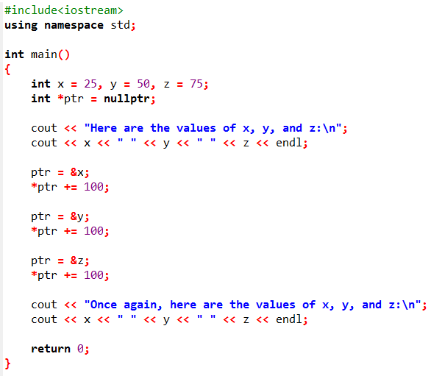
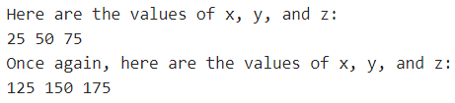
Example demonstrates that pointers can point to different variables.

Slide 22
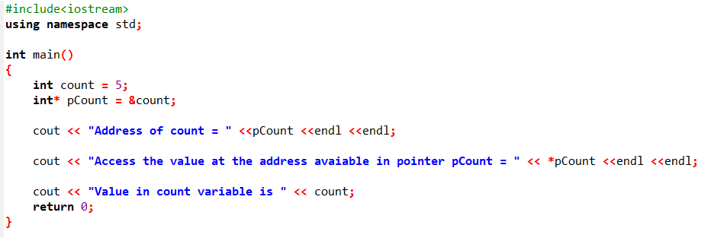
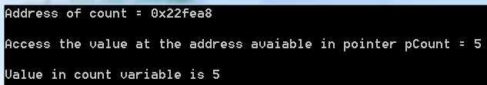
What is the output?

Slide 23
Next Lecture
The relationship between array and pointers
Pointers Arithmetic

